Slide 1






PRESENTATION 2026
Smart Payroll Analytics and Financial Optimization
Student Name
Student Email
Pooja Rohit Mandal
poojaman776@gmail.com
Mentor Name
Ms. Umamaheshwari

Slide 2

Outline
Abstract of the Project
Problem Statement
Proposed Solution
System Architecture
Live Demo of the Project
Embedded Video of Project
Conclusion
Future Scope

Slide 3
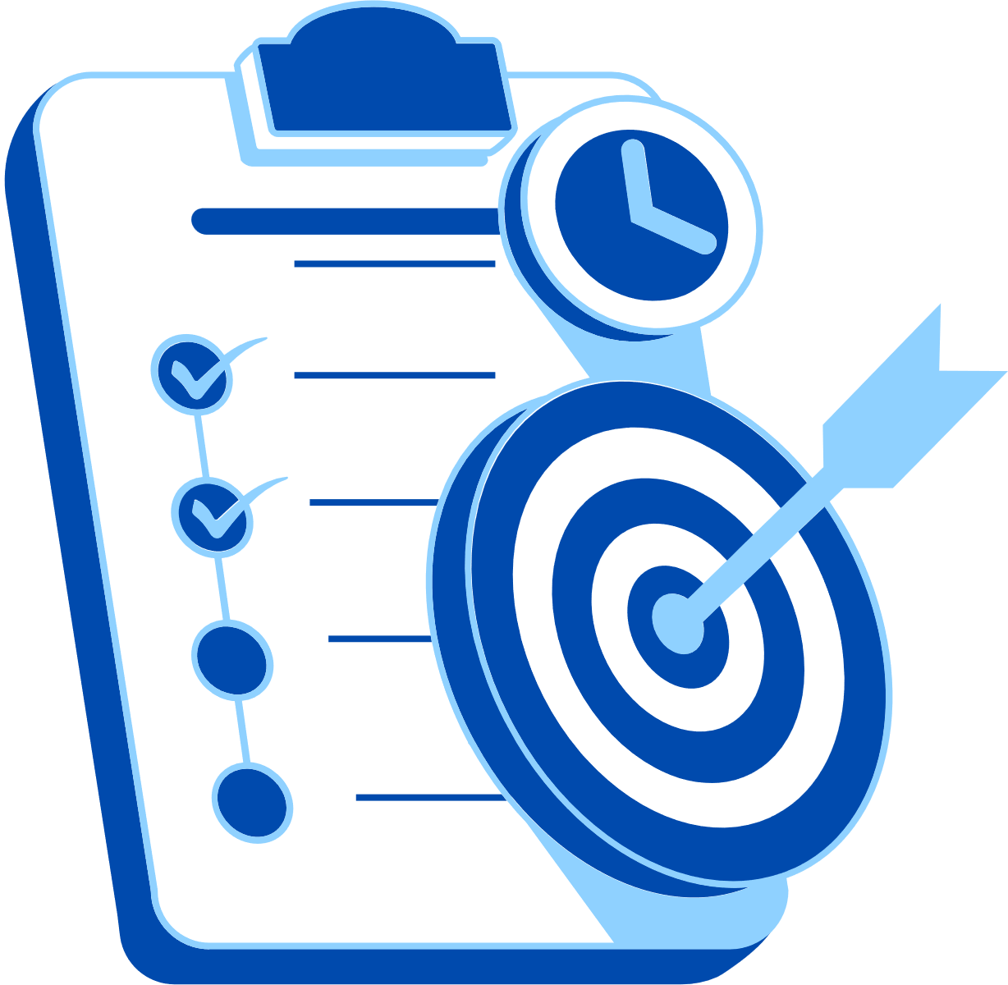
Abstract
This project focuses on transforming employee payroll data by converting traditional payroll systems into a more efficient, accurate, and automated digital process. The objective is to streamline payroll operations, reduce manual errors, and ensure compliance with financial regulations while improving transparency and reliability. The project uses tools such as Microsoft Excel for data management and SQL for database handling and integration. The expected outcomes include faster payroll processing, improved data accuracy, reduced workload, and better accessibility of payroll information. A key highlight of this project is the integration and automation of payroll data into a centralized system.

Slide 4

Problem Statement
Business related problems
Unoptimized Payroll Workflow with Low Data Accuracy
Inaccurate Payroll Processing with Poor Data Integrity
Fragmented Payroll Data with Poor System Integration
Poorly Managed Payroll System with Security Risks
Unreliable Payroll Processing with Compliance Risks

Slide 5

Proposed Solution
This project uses Excel and Power BI to solve inventory and fulfillment issues.
Compliance Tracking with Predefined Rules and Reports
Scalable Reporting using Power BI Data Models
Workflow Optimization through Process Automation
Role-Based Access Control and Data Security Measures
Improved Data Integrity with Single Source of Truth

Slide 6
System Architecture
Data Input / Source
Processing / Analysis
Employee Payroll dataset from Kaggle / Excel
Contains employee details, department, salary components (Basic Pay, Allowances, Deductions), attendance, tax, and net salary
Data cleaning and preprocessing using Excel
Payroll calculations using formulas (Net Salary, Tax, Deductions)
KPI calculation using Power BI (Total Salary, Average Salary, Department-wise Expenses)
AI / Tool Integration
Output / Dashboard
Power BI for visualization and dashboard creation
AI tools (ChatGPT / Copilot) for insights, report generation, and interpretation
Interactive Power BI dashboard with KPI cards and visualizations
Provides insights on salary distribution, payroll expenses, deductions, and department-wise analysis

Slide 7
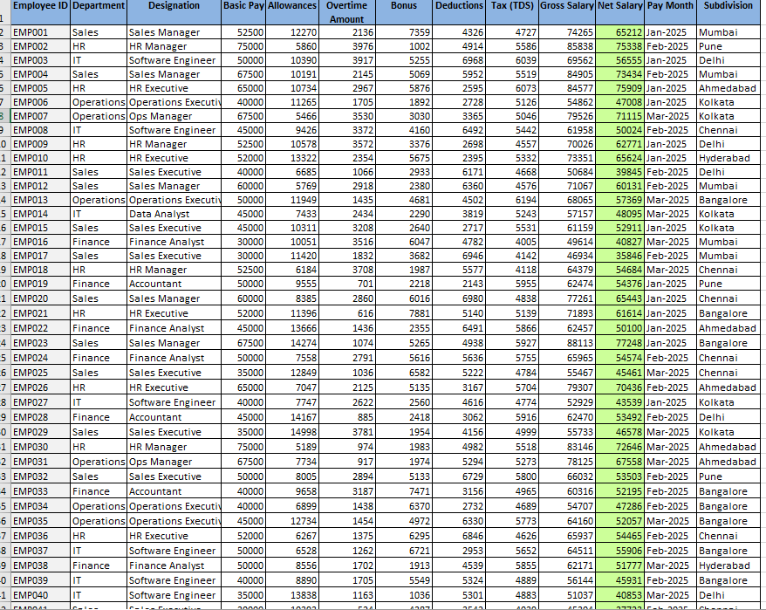
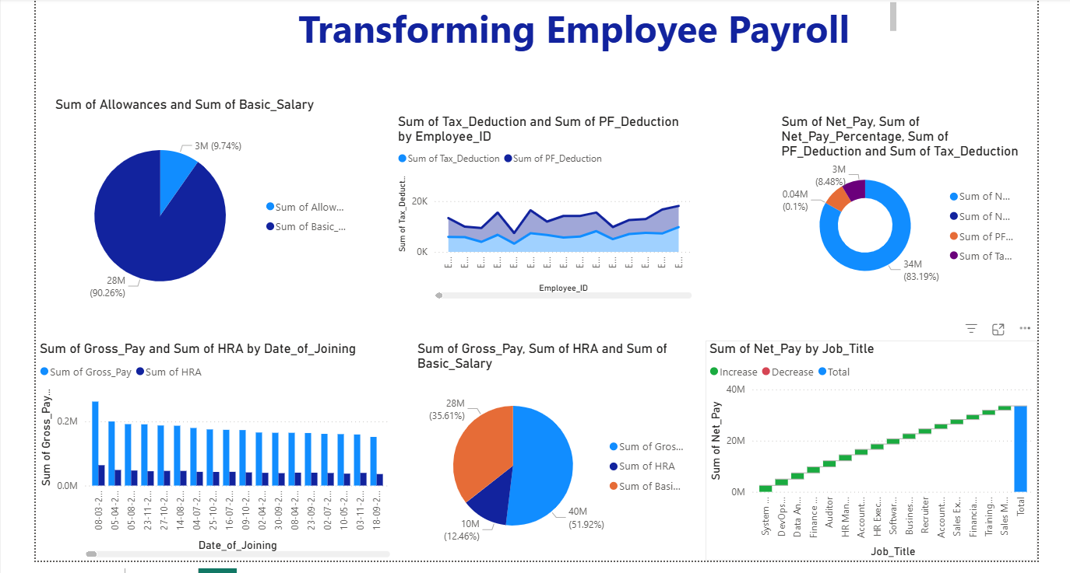
Live Demo of Project
Here's the list of some demo screenshots / features of the project:
Demo 1
Demo 3

Slide 8
Video of Project Demo
▶
[Insert your project demo video.
You can embed a video your live project.]

Slide 9

Conclusion
This project successfully converted raw payroll data into structured and meaningful information using Excel and Power BI.
Key achievements:
Cleaned and organized employee payroll dataset
Performed accurate payroll data analysis
Created interactive dashboards for salary insights
Improved payroll processing and reporting efficiency
The project demonstrates how Excel and Power BI can be effectively used for payroll management, data analysis, and better decision-making in organizations.
CONCLUSION

Slide 10
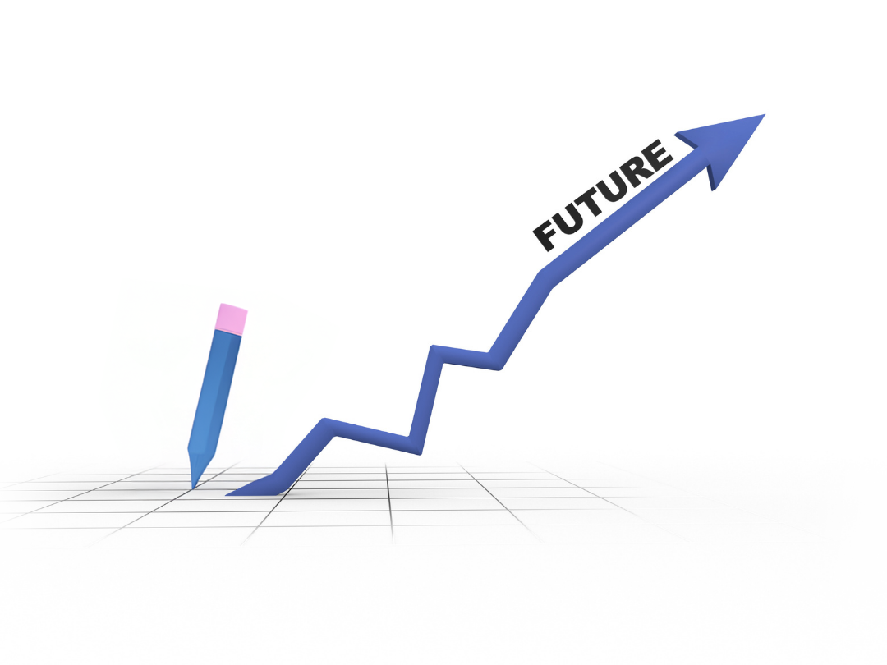
Future Scope
Integration with AI & Machine Learning
Cloud-Based Payroll Systems
Advanced Data Analytics
Blockchain for Secure Transactions
Automation & Self-Service Portals
Compliance & Global Payroll Management

Slide 11
Thank You
AICW Fellowship | Student Project Presentation 2026
LinkedIn | Edunet Foundation

